Slide 1
Farmer Crop Management System through mobile application and voice interface
Government of Tamilnadu

Slide 2
Objective & Technology Innovation
To meet the goal of doubling the Agricultural productivity thereby increasing farmers income
To provide an innovative approach for farm level planning
To convert paper-based baseline survey data collection from farmers into efficient, paperless data collection through mobile phone application and voice interface

Slide 3
STEPS OF MOBILE APPLICATION - Currently fetches information for 6 districts

Slide 4
Personal Details of the farmer

Slide 5
Bank Details of the farmer – Bank,Branch and PACCS will be from DB

Slide 6
Land Details

Slide 7
Farm Animals

Slide 8
Farm Machineries

Slide 9
Other Information

Slide 10
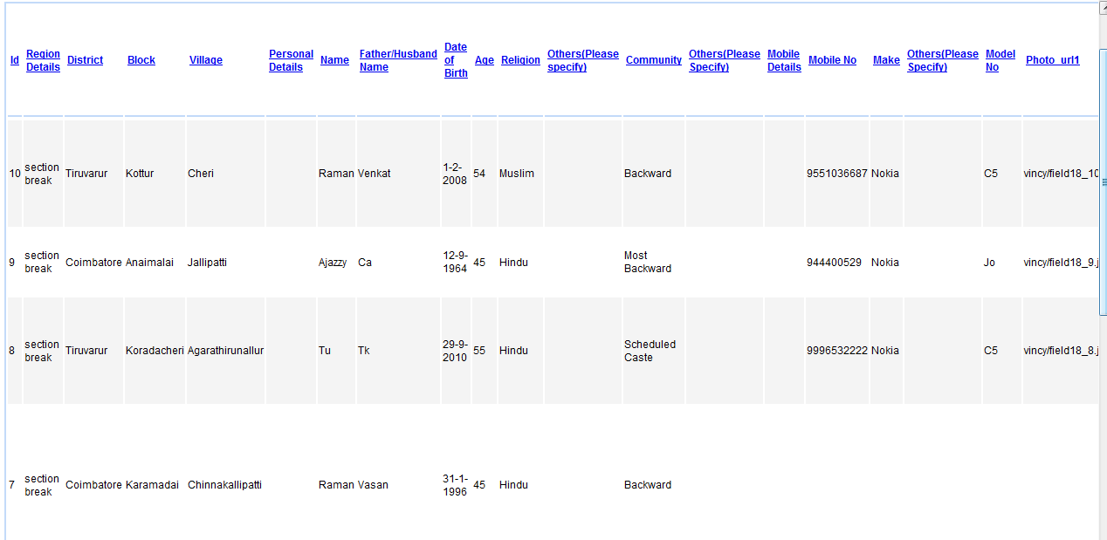
Data submitted can be viewed

Slide 11
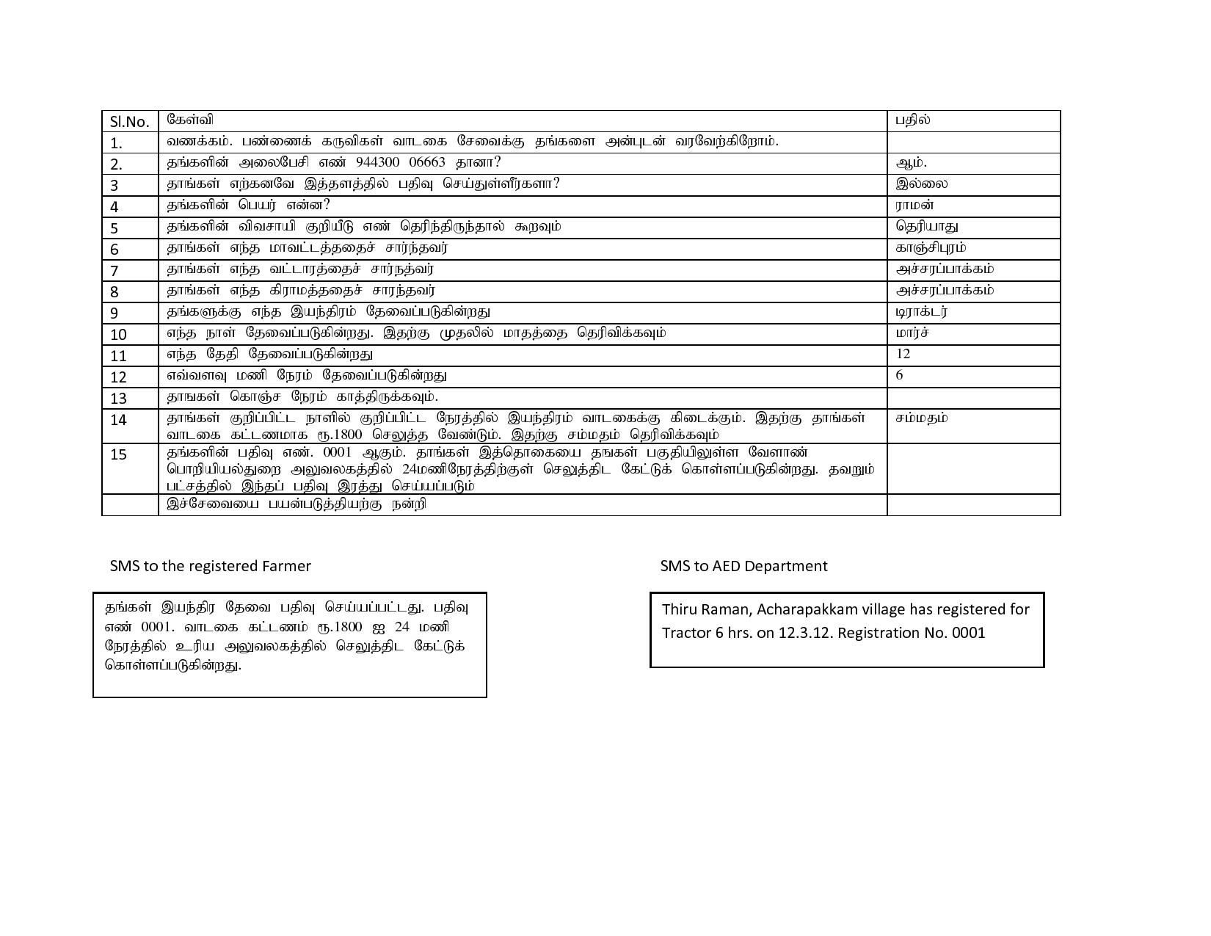
FARM MACHINERY RENTAL PROCESS

Slide 12
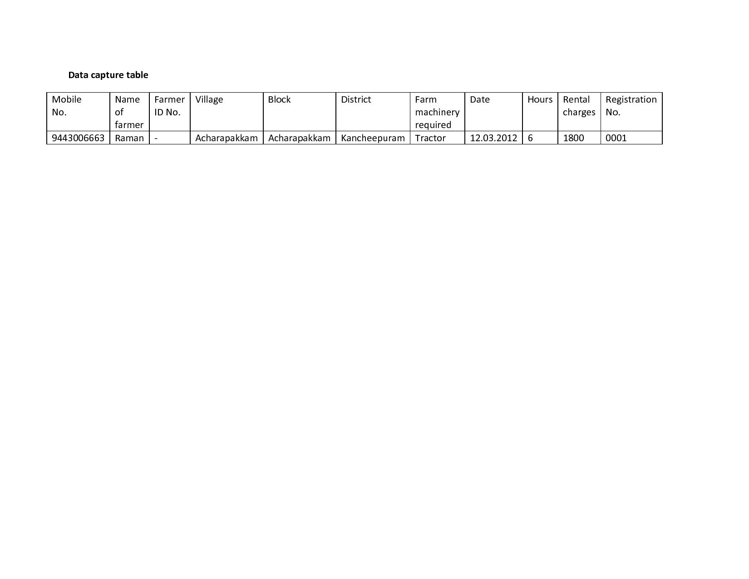

Slide 13
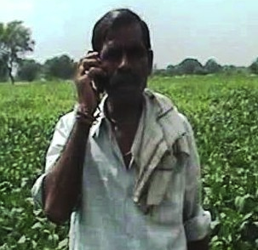
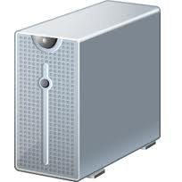
STEPS OF VOICE APPLICATION
How is it done
Farmer calls the Farmer Crop Management System using his own mobile phone or landline
System then interacts with the farmer in Tamil to capture the relevant information
System: Welcome to Farmer Crop Management System. Please say district name.
User: Vellore
System: Please say village name
Customer: Beemakulam
System: In which bank do you have account?
Customer: State Bank of India.
Farmer Crop Management System
Sample Call (click here)

Slide 14
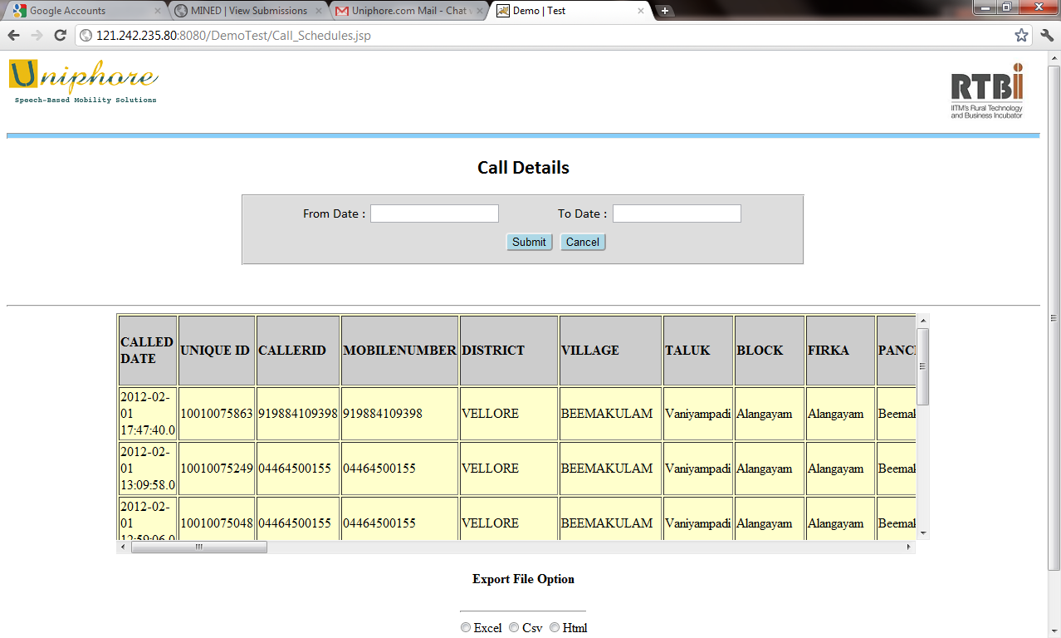
The information is transcribed and made available on the web interface for report generation

Slide 15
THANK YOU

